Slide 1
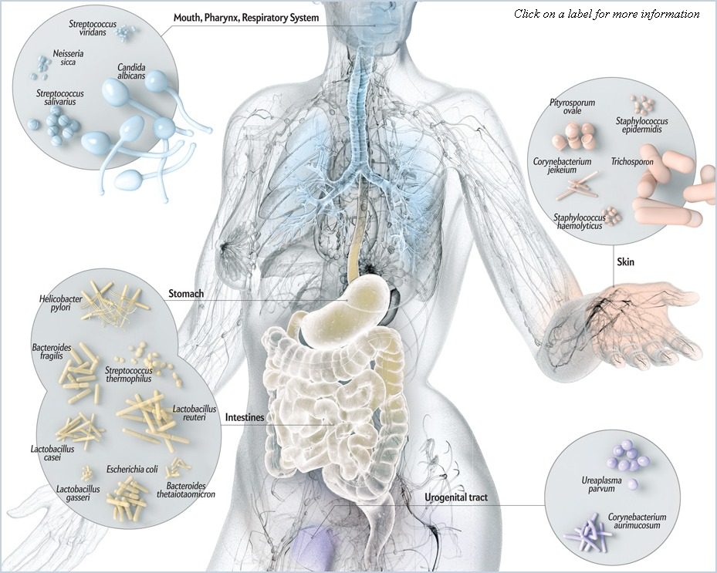
Analyzing the Microbiome
Notes:
Lead a discussion about the microbiome/microbiota and why it’s so important to study
How might the microbiom affect health?
Where do the microbes come from?
What could affect the microbiome of an organism?

Slide 2

Describing the microbiome: Alpha diversity
“a dynamic and interactive micro-ecosystem”
Alpha diversity measures richness and evenness of community
Richness: Number of different taxa in a community
Evenness: Distribution of organisms within taxa in a community.

Slide 3



Describing the microbiome: Alpha diversity
Community 1
Community 2
Community 3
Richness is just observed # of taxa.
Various indices (Shannon, inverse Simpson, etc.) calculate an alpha diversity score accounting for both richness and evenness.

Slide 4
Describing the microbiome: Beta diversity
Beta diversity reflects the degree of differentiation among communities
Richness: Number of different taxa in a community
Evenness: Distribution of organisms within taxa in a community.

